Slide 1

Lost items Management
S.No. | Admission Number | Student Name | Degree / Branch | Sem
1. | 20SCSE1010759 | Pallavi Kumari | B.TECH / CSE | III
2. | 20SCSE1010767 | Md Nadeem Sarwar | B.TECH / AIML | III
3. | 20SCSE1010729 | Ziyauddin Zamir | B.TECH / CSE | III
Under the Supervision of
Ms. Shivani Sharma
School of Computing Science and Engineering
Greater Noida, Uttar Pradesh Fall 2020 – 2021

Slide 2
TABLE OF CONTENTS
S.No. | Particulars
1. | Introduction of lost items management
2. | Why Implement It?
3. | What computer languages are used?
4. | How the lost item management system will work?
5. | Data Base management
6. | Diagram of lost items management
7. | Activities, Fragments, Classes, Adapters
TABLE OF CONTENTS

Slide 3
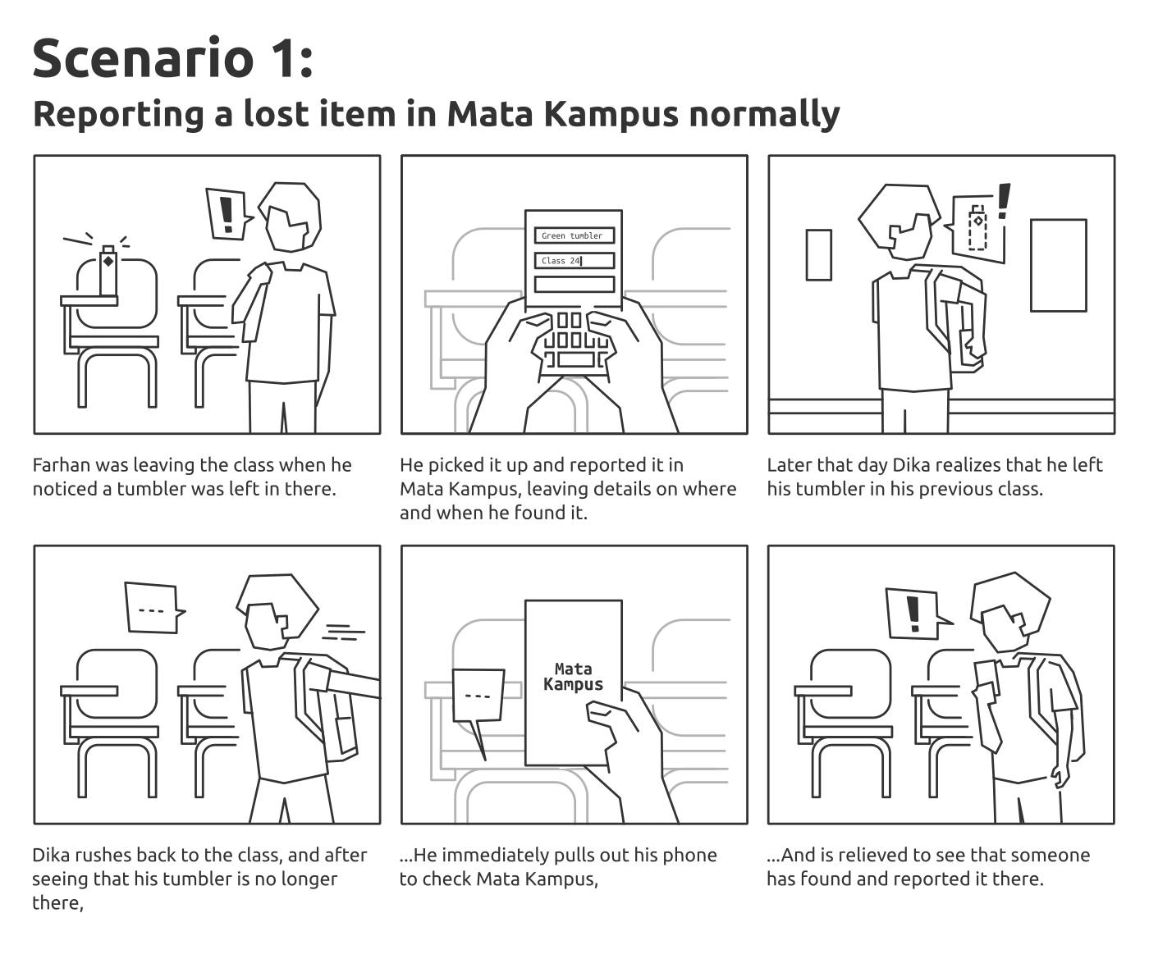
Introduction Of Lost items Management
Universities are busy places. There is a lot of coming and going. People are moving from one class to the next. They also frequent the hangouts between classes and are all over the campus. When people are this busy some of their personal items may get lost. A person may take their coat off and forget it. Students lose their briefcases and bags all of the time. There can be some personal information or items of sentimental value that accidentally get left behind. Many universities have lost and found boxes but people may not know where they are located to check for items. Universities can help students and other visitors get their items back. Lost and found software make it easy to post and manage items that have been lost and turned into the university.

Slide 4
The implementation of lost and found software for universities is necessary in order to save time in the management of lost and found item inventory and in matching up these items with their rightful owners for return. It alleviates the need for maintaining a hand-written or computer-generated inventory list which must be updated constantly and individually checked each time someone calls the school asking after a particular item that may or may not have been left behind. The app makes it very easy to search for items from the palm of your hand, with any online device. Easy and convenient for everyone. And it gives you time to come up with a good explanation for that human skeleton you’ll be bringing home!
Why Implement It?

Slide 5
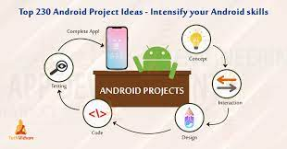
How the lost item management
system will work?

Slide 6
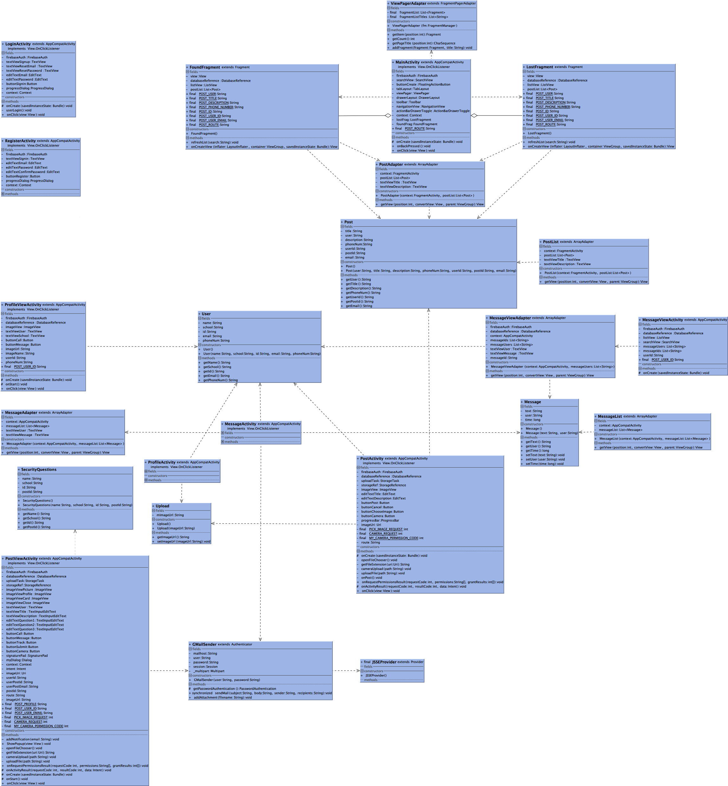
What computer languages are used?

Slide 7
Usage
Open up the app and create an account.
Verify the account using the email you registered with.
Login and set up your profile and save your information.
Technologies
Material UI
Android
Firebase

Slide 8
Table structure for table found listing CREATE TABLE IF NOT EXISTS `found_listing` ( `id` int(11) NOT NULL AUTO_INCREMENT, `date_found` date DEFAULT NULL, `item_name` varchar(45) NOT NULL, `found_location` varchar(45) NOT NULL, `returned_to` varchar(45) NOT NULL, `users_id` int(10) unsigned NOT NULL, `date_added` date DEFAULT NULL, PRIMARY KEY (`id`,`users_id`), KEY `fk_found_listing_users1_idx` (`users_id`) 11 Dumping data for table found_listing INSERT INTO `found_listing` (`id`, `date_found`, `item_name`, `found_location`, `returned_to`, `users_id`, `date_added`) Table structure for table lost_listing CREATE TABLE IF NOT EXISTS `lost_listing` ( `id` int(10) unsigned NOT NULL AUTO_INCREMENT, `date_added` date DEFAULT NULL, `date_lost` date DEFAULT NULL, `item_name` varchar(45) NOT NULL, `user_name` varchar(45) NOT NULL, `user_email` varchar(80) NOT NULL, `user_phone` varchar(15) NOT NULL, `lost_location` varchar(45) NOT NULL, `description` varchar(10000) DEFAULT NULL, `users_id` int(10) unsigned NOT NULL, PRIMARY KEY (`id`,`users_id`), KEY `fk_lost_listing_users_idx` (`users_id`) ) Dumping data for table lost_listing INSERT INTO `lost_listing` (`id`, `date_added`, `date_lost`, `item_name`, `user_name`, `user_email`, `user_phone`, `lost_location`, `description`, `users_id`) Table structure for table users CREATE TABLE IF NOT EXISTS `users` ( `id` int(10) unsigned NOT NULL AUTO_INCREMENT, `username` varchar(15) DEFAULT NULL, `password` varchar(20) NOT NULL, `email` varchar(100) NOT NULL, `name` varchar(50) NOT NULL, `admin` tinyint(4) DEFAULT '0', `phone` varchar(15) DEFAULT NULL, PRIMARY KEY (`id`), UNIQUE KEY `unique_email` (`email`), UNIQUE KEY `username_UNIQUE` (`username`) ) Dumping data for table users INSERT INTO `users` (`id`, `username`, `password`, `email`, `name`, `admin`, `phone`)
Database
Design

Slide 9
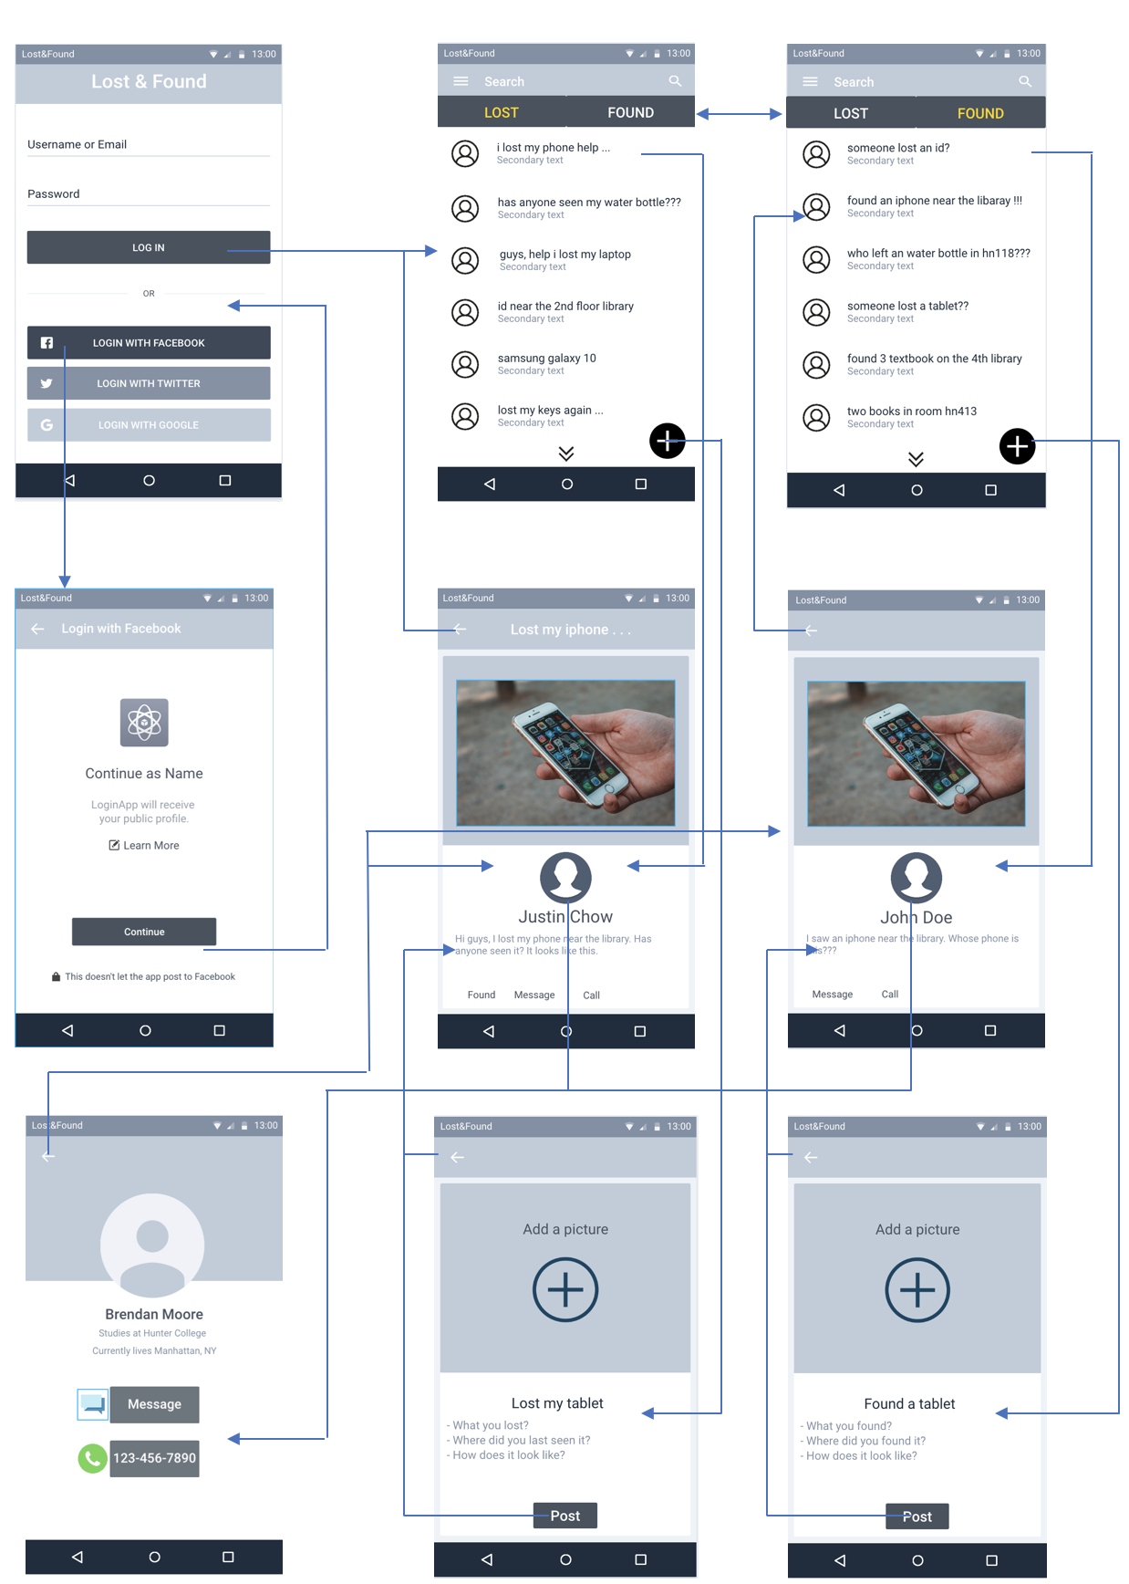
Diagram of lost items management

Slide 10

LoginActivity - Activity for user to enter their email and password.
RegisterActivity - Activity for user to register for an account using their email and password.
MainActivity - Home activity for user to view between the Lost & Found tab to see other users' post.
MessageActivity - Activity to allow user to message another user.
MessageViewActivity - Activity to view chats the user has created.
PostActivity - Activity to allow user to post for a lost or found item.
PostViewActivity - Activity to view other user’s post, either lost or found.
ProfileActivity - Activity to view the user's profile and edit user's information.
ProfileViewActivity - Activity to view other user's profile
Activities

Slide 11

Fragments
LostFragment - Fragment of the Lost tab.
FoundFragment - Fragment of the Found tab.
Message - Class to hold a message data e.g. user and message.
MessageList - Class to hold all message data of that user.
Post - Class to hold a post information (e.g. title and description).
PostList - Class to hold all post data of either Lost or Found tab.
SecurityQuestions - Class to hold the security questions when a user want to track and contact other user.
Upload - Class to hold the post image url.
User - Class to hold a user information e.g. name, phonenumber, id,and school
GMailSender - Class to send email to a user gmail account when a user is using track feature.
JSSEProvider - Class to send email to a user gmail account when a user is using track feature.
Classes

Slide 12

MessageAdapter - Extends ArrayAdapter to populates a list of messages into a messageview.
MessageViewAdapter - Extends ArrayAdapter to populates a list of chats into a chatting view.
PostAdapter - Extends ArrayAdapter to populates a list of posts into a Lost or Found fragment view.
ViewPagerAdapter - Extends FragmentPagerAdapter to add fragments,lost & found, to switch between lost & found tab.
Adapters

Slide 13


